Slide 1
Artificial Intelligence
1

Slide 2
Text Book
Text book:
Artificial Intelligence: A Modern Approach by Stuart Russell & Peter Norvig (Fourth Edition)
Recommended books:
Artificial Intelligence and Intelligent Systems, N.P. PADHY
Practical Artificial Intelligence Programming with java, Mark Watson
3

Slide 3
What is AI??
Artificial + Intelligence
5

Slide 4
What is Intelligence?
Intelligence:
“The capacity to learn and solve problems” (Websters dictionary)
in particular,
the ability to solve novel problems
the ability to think & act rationally
the ability to think & act like humans
Artificial Intelligence
build and understand intelligent entities or agents
Two main approaches: “engineering” versus “cognitive modeling”
6

Slide 5
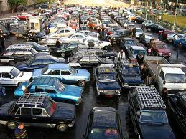
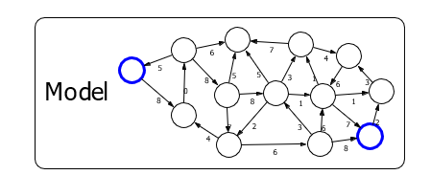
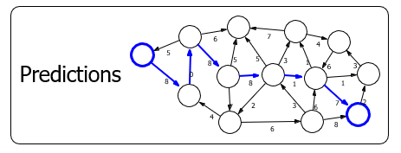
What’s involved in Intelligence?
Real world

Slide 6
What’s involved in Intelligence?
Ability to interact with the real world
to perceive, understand, and act
e.g., speech recognition and understanding and synthesis
e.g., image understanding
e.g., ability to take actions, have an effect
Reasoning and Planning
modeling the external world, given input
solving new problems, planning, and making decisions
ability to deal with unexpected problems, uncertainties
Learning and Adaptation
we are continuously learning and adapting
our internal models are always being “updated”
e.g., a baby learning to categorize and recognize animals
7

Slide 7
Artificial Intelligence as Science
Physics: Where did the physical universe
come from and what laws guide its dynamics?
Biology: How did biological life evolve and how do living organisms function?
two sciences, seeks to answer fundamental questions about its respective domain
Artificial Intelligence: What is the nature of “intelligence” and what constitutes intelligent behavior?
8

Slide 8
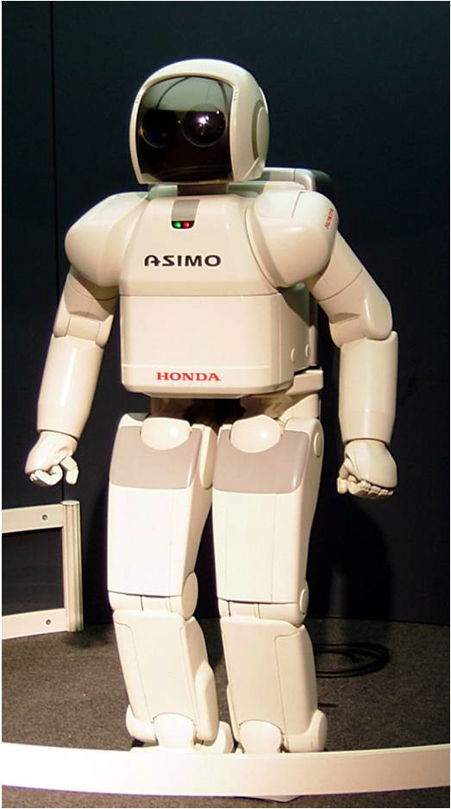
Artificial Intelligence as Engineering
How can we make software and machines more
powerful, adaptive, and easier to use?
Examples:
Speech recognition
Natural language understanding
Computer vision and image understanding
Intelligent user interfaces
Data mining
Mobile robots, Softbots, Humanoids Medical expert systems…
9

Slide 9
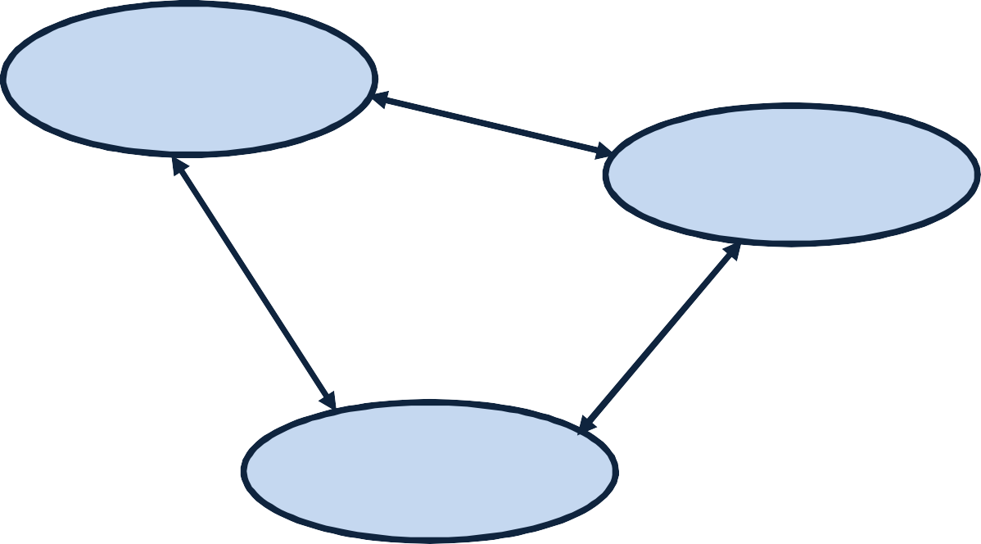
What is AI? A simple Definition
AI is the attempt for the reproduction of human reasoning and intelligent behavior by computational methods
Intelligent behavior
Computer
Humans
10

Slide 10
What is AI?
Four possible ways to define Artificial Intelligence i.e.
A discipline that systematizes and automates reasoning processes to create machines that:
Act like humans Think like humans
Act rationally Think rationally

Slide 11
Act like humans Think like humans
Act rationally Think rationally
The goal of AI is to create computer systems that perform tasks regarded as requiring intelligence when done by humans.
In this AI Methodology we take a task at which people are better, e.g.:
Prove a theorem
Play chess
Plan a surgical operation
Diagnose a disease
Navigate in a building
and build a computer system that does it automatically
But HUMANS MAKE ERRORS,,,,,do we want to duplicate or copy human imperfections?
12

Slide 12
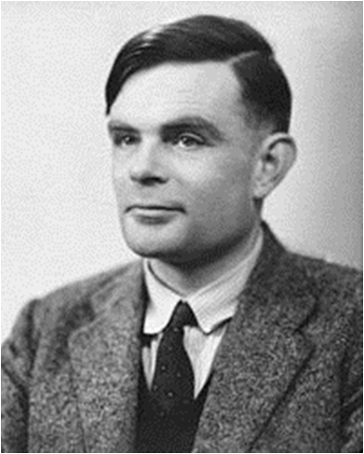
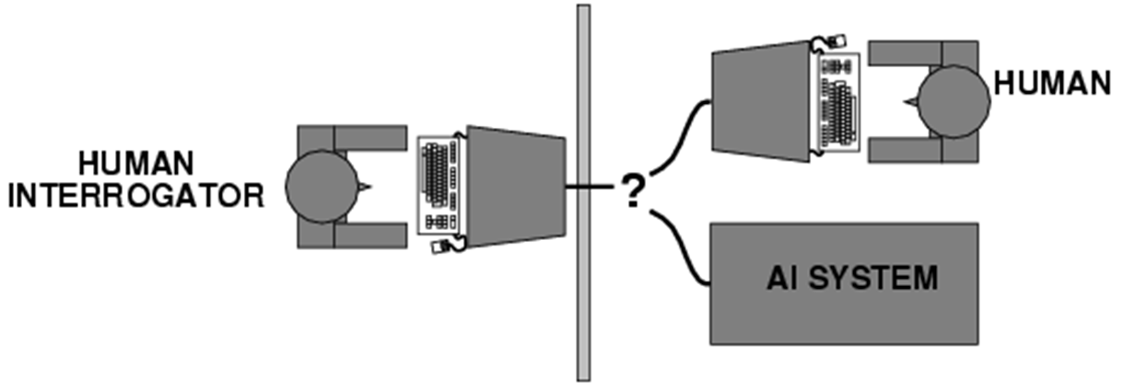
AI definition 01: Act Like Humans
The Turing Test
What capabilities would a computer need to have to pass the Turing Test?
Natural language processing
Knowledge representation
Automated reasoning
Machine learning
Turing predicted that by the year 2000, machines would be able to fool 30% of human judges for five minutes
A. Turing, Computing machinery and intelligence, Mind 59, pp. 433-460, 1950

Slide 13
Eliza – A partial success…
ELIZA: A program that simulated a psychotherapist interacting with a patient and successfully passed the Turing Test.
Coded at MIT during 1964-1966 by Joel Weizenbaum.
First script was DOCTOR.
The script was a simple collection of syntactic patterns (Tom went home.” It's a full thought with a subject and verb)
Each pattern had an associated reply which might include bits of the input (after simple transformations (my → your)
Weizenbaum was shocked at reactions:
Psychiatrists thought it had potential.
People unequivocally related it to humans like response.
Many thought it solved the NL problem.

Slide 14
An Application of the Turing Test
CAPTCHA: Completely Automatic Public Turing tests to tell Computers and Humans Apart
▪ E.g.:
Display visually distorted words
Ask the user to recognize these words
Example of application: Have only humans open email accounts

Slide 15
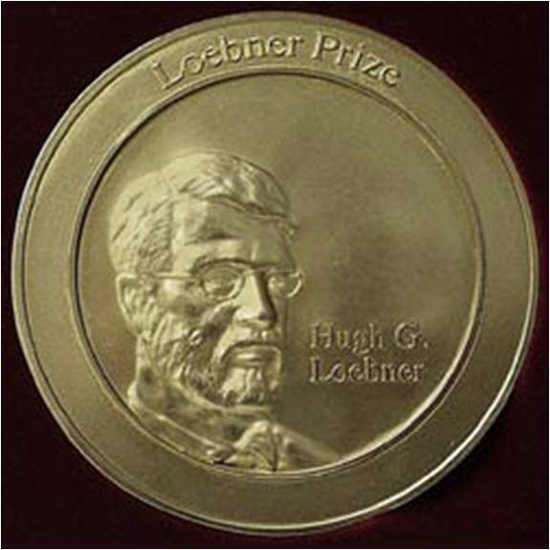
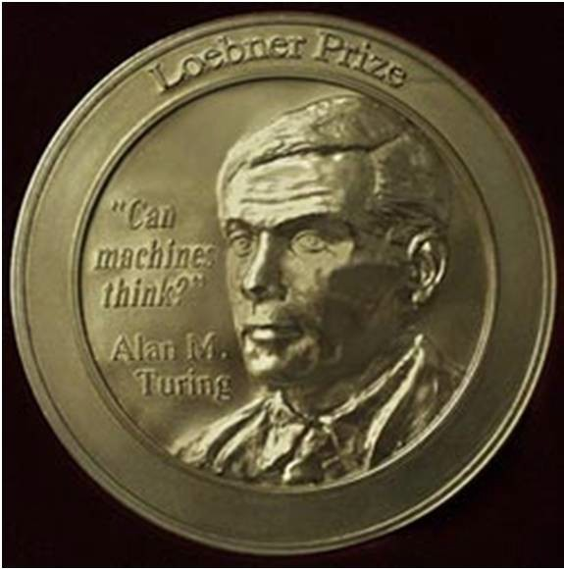
The Turing Test
Turing predicted that by the year 2000, machines would be able to fool 30% of human judges for five minutes
Loebner prize
2008 competition: each of 12 judges was given five minutes to conduct simultaneous, split-screen conversations with two hidden entities (human and chatterbot). The winner, Elbot of Artificial Solutions, managed to fool three of the judges into believing it was human [Wikipedia].

Slide 16
What’s wrong with the Turing test?
Variability in protocols and judges: The test's outcomes can be influenced by the specific protocols used and the subjective judgments of the judges.
Success depends on deception: A machine can pass the test by deceiving the judges into believing it is human, rather than truly understanding or exhibiting intelligence.
Chatbots can do well using "cheap tricks": Chatbots can often perform well on the Turing test by using simple techniques, such as pattern recognition and scripted responses, without necessarily understanding the underlying meaning of the conversation.
ELIZA (1966) as an early example of a chatbot that could pass the Turing test using these "cheap tricks."

Slide 17
A better Turing test?
Multiple choice questions that can be easily answered by people but cannot be answered by computers using “cheap tricks”:
The trophy would not ﬁt in the brown suitcase because it was so small.
What was so small?
The trophy
The brown suitcase

Slide 18
A better Turing test?
Multiple choice questions that can be easily answered by people but cannot be answered by computers using “cheap tricks”:
The trophy would not ﬁt in the brown suitcase because it was so large.
What was so large?
The trophy
The brown suitcase
H. Levesque, On our best behaviour, IJCAI 2013

Slide 19
A better Turing test?
Advantages over standard Turing test
Test can be administered and graded by machine
Does not depend on human subjectivity
Does not require ability to generate English sentences
Questions cannot be evaded using verbal dodges
Questions can be made “Google-proof” (at least for now…)

Slide 20
Act like humans Think like humans
AI definition 02: Think Like Humans
Act rationally Think rationally
In this type of approach to AI, how the computer performs tasks does matter and are inspired by human thinking.
The reasoning steps are important…… done in the same fashion as humans process thoughts…
Ability to create and manipulate symbolic knowledge
(definitions, concepts, theorems, …)
Example GPS (General Problem Solver): solved simple problems such as the Towers of Hanoi that could be sufficiently formalized.
23

Slide 21
Act like humans Think like humans
AI definition 02: Think Like Humans
Act rationally Think rationally
Cognitive Science approach
Try to get “inside” our minds
e.g., conduct experiments with people to try to “reverse-engineer” how we reason, learn, remember, predict
Problems
Humans don’t behave rationally
e.g., insurance, politically motivated debate
The reverse engineering is very hard to do
The brain’s hardware is very different to a computer program
24

Slide 22
Act like humans Think like humans
Act rationally Think rationally
In this type of approach to AI, the goal is to build agents that always make the “best” decision given what is available (knowledge, time, resources)
“Best” means maximizing the expected value
What is the impact of self-consciousness, emotions, desires, love for music, fear of dying, etc ... on human intelligence? Are they part of Human Intelligence?
28

Slide 23
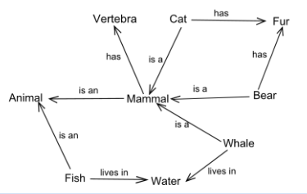
AI definition 03: Thinking rationally
Idealized or “right” way of thinking
Logic: patterns of argument that always yield correct conclusions when supplied with correct premises
“Socrates is a man; all men are mortal; therefore Socrates is mortal.”
Logicist approach to AI: describe problem in formal logical notation and apply general deduction procedures/rules to solve it
Problems with the logicist approach
Computational complexity of finding the solution
Describing real-world problems and knowledge in logical notation; because not all facts are 100% true.
Dealing with uncertainty/expected value
A lot of “rational” behavior has nothing to do with logic.

Slide 24
AI definition 04: Acting rationally
A rational agent acts to optimally achieve its goals
Goals are application-dependent and are expressed in terms of the utility of outcomes
Being rational means maximizing your (expected) utility
This definition of rationality only concerns the decisions/actions that are made, not the cognitive process behind them.
In practice, utility optimization is subject to the agent’s computational constraints (bounded rationality or bounded optimality)

Slide 25
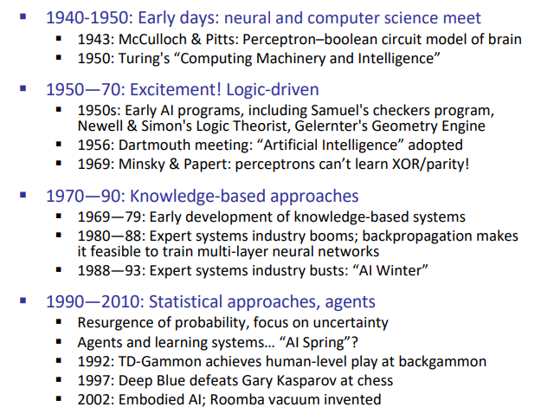
History of AI

Slide 26
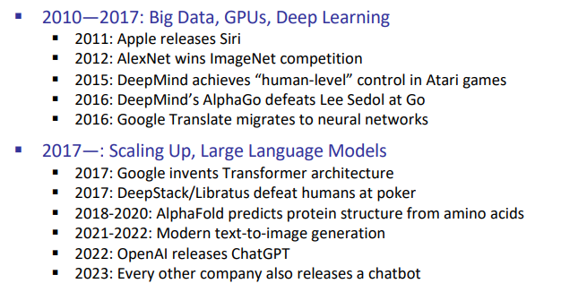
History of AI

Slide 27
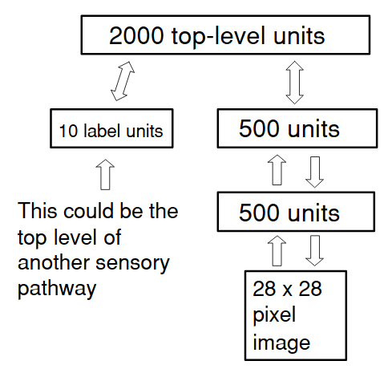
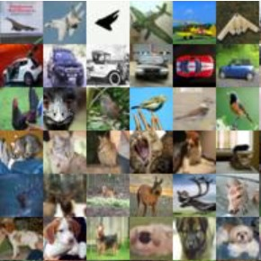
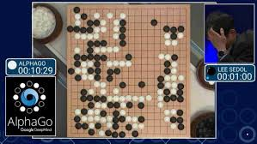
Deep learning
2006: unsupervised layerwise pre-training of deep networks (Hinton et al.)
2012: AlexNet obtains huge gains in object recognition; transformed computer vision community overnight
2016: AlphaGo uses deep reinforcement learning, defeat world champion Lee Sedol in Go
CS221
104

Slide 28
Can Machines Act/Think Intelligently?
After All this Debate the question remains….
Yes, if intelligence is narrowly defined as information processing
AI has made impressive achievements showing that tasks initially assumed to require intelligence can be automated
▪

Slide 29
Success Stories AI Systems

Slide 30
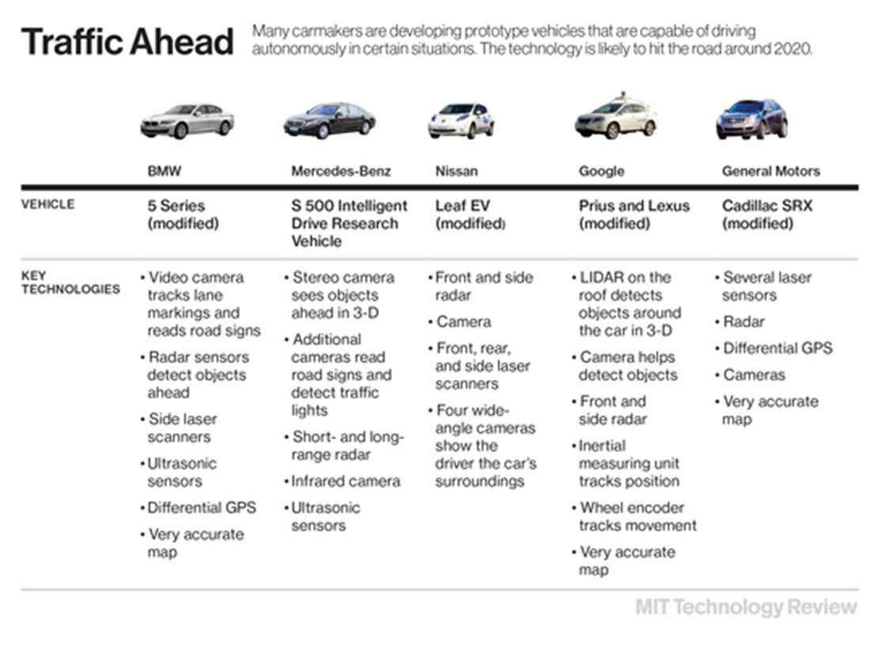
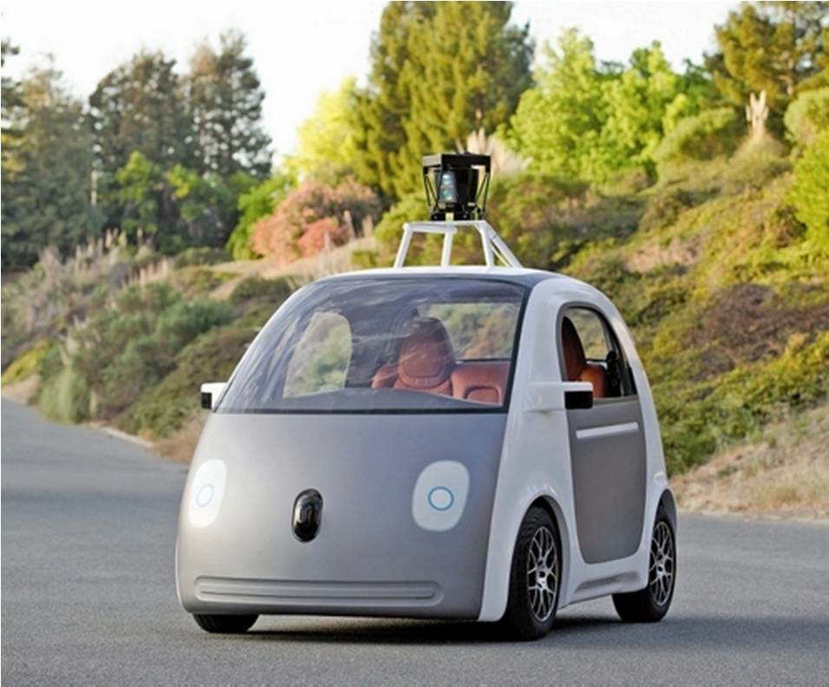
Self-driving cars
http://www.technologyreview.com/featuredstory/520431/d riverless-cars-are-further-away-than-you-think/
Google plans to assemble a test fleet of 100 electric two-seat prototypes in 2015
Uber employee of the future: The self-driving car

Slide 31

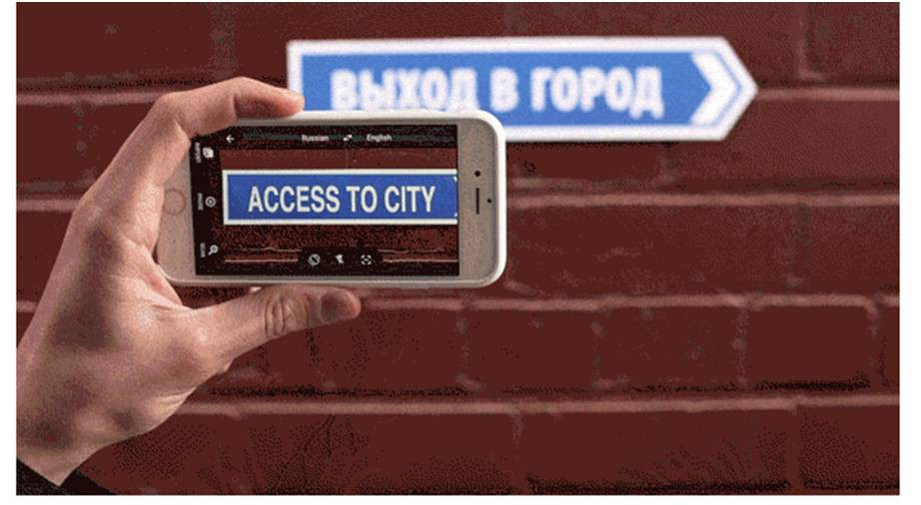
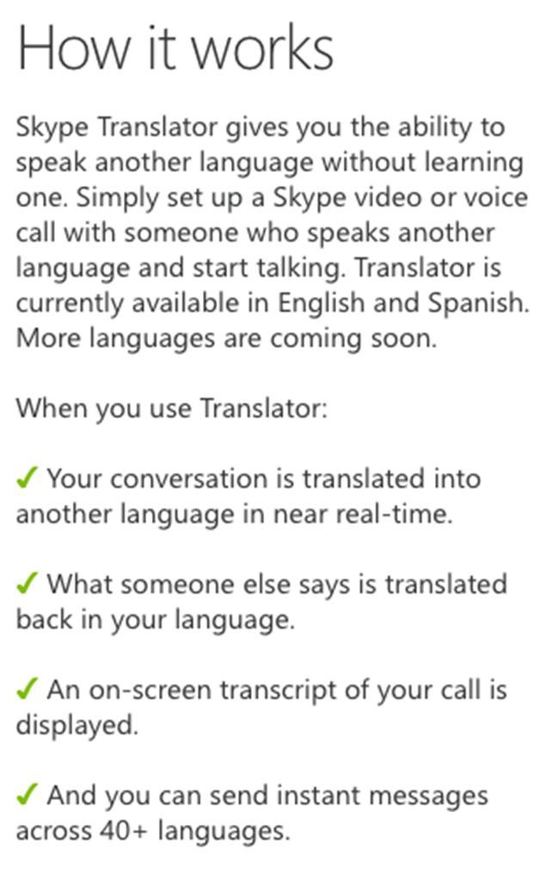

Speech and natural language
Instant translation with Word Lens
Have a conversation with Google Translate
http://www.skype.com/en/translator-preview/
http://googleblog.blogspot.com/2015/01/hallo-hola-ola- more-powerful-translate.html

Slide 32
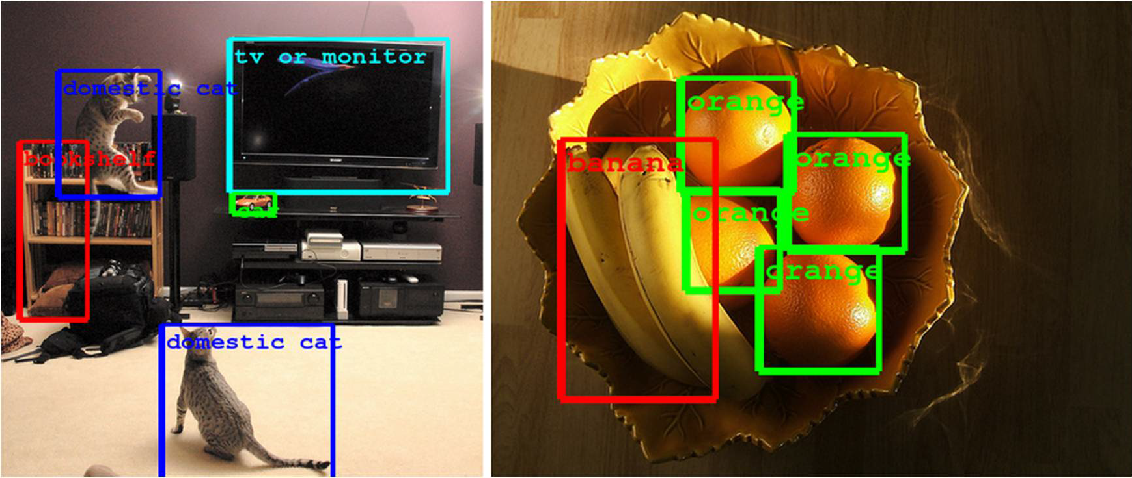
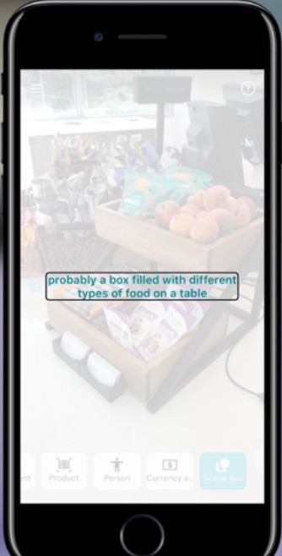
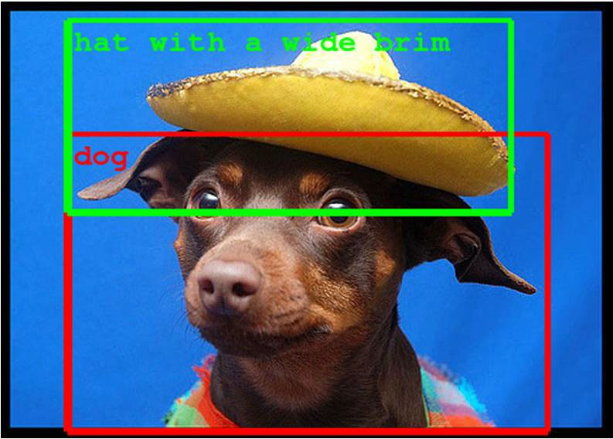
Vision

Slide 33

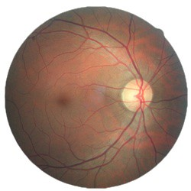
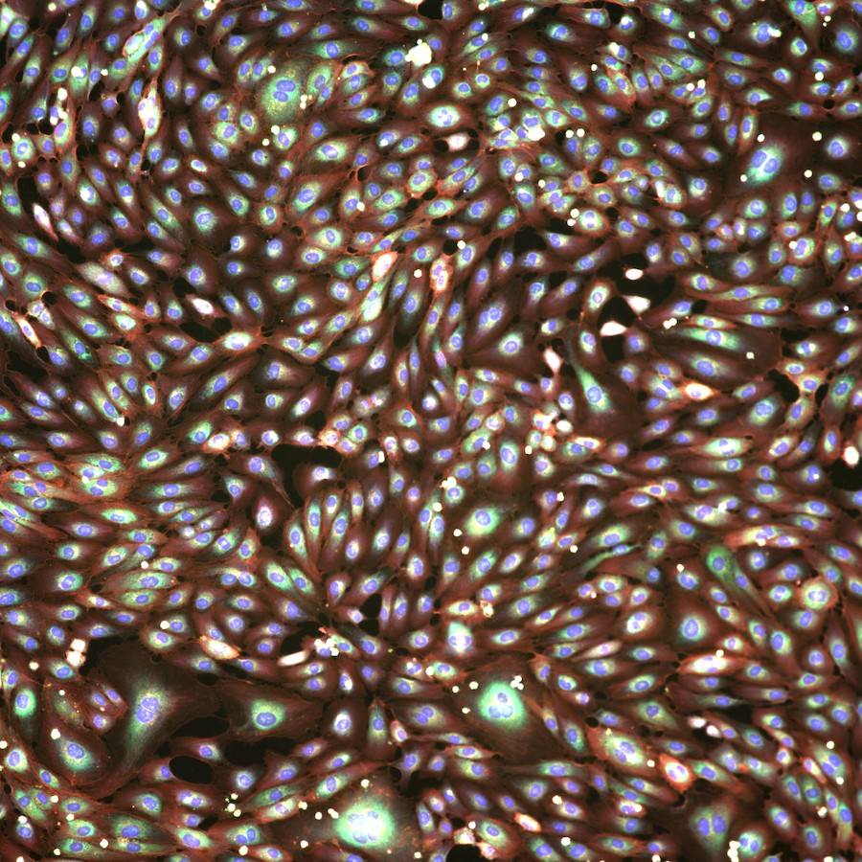
Healthcare
Chest radiology
Diabetic retinopathy
Drug screening for COVID-19
CS221

Slide 34


Poverty mapping
CS221
136

Slide 35
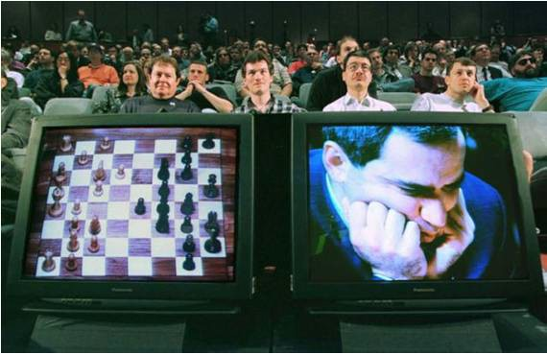
Games
1997: IBM’s Deep Blue defeats the reigning world chess champion Garry Kasparov
1996: Kasparov Beats Deep Blue
“I could feel – I could smell – a new kind of intelligence across the table.”
1997: Deep Blue Beats Kasparov
“Deep Blue hasn't proven anything.”
2007: Checkers is solved
Though checkers programs had been beating the best human players for at least a decade before then
2014: Heads-up limit Texas Hold-em poker is solved
First game of imperfect information
2015: Deep reinforcement learning beats humans at classic arcade games

Slide 36

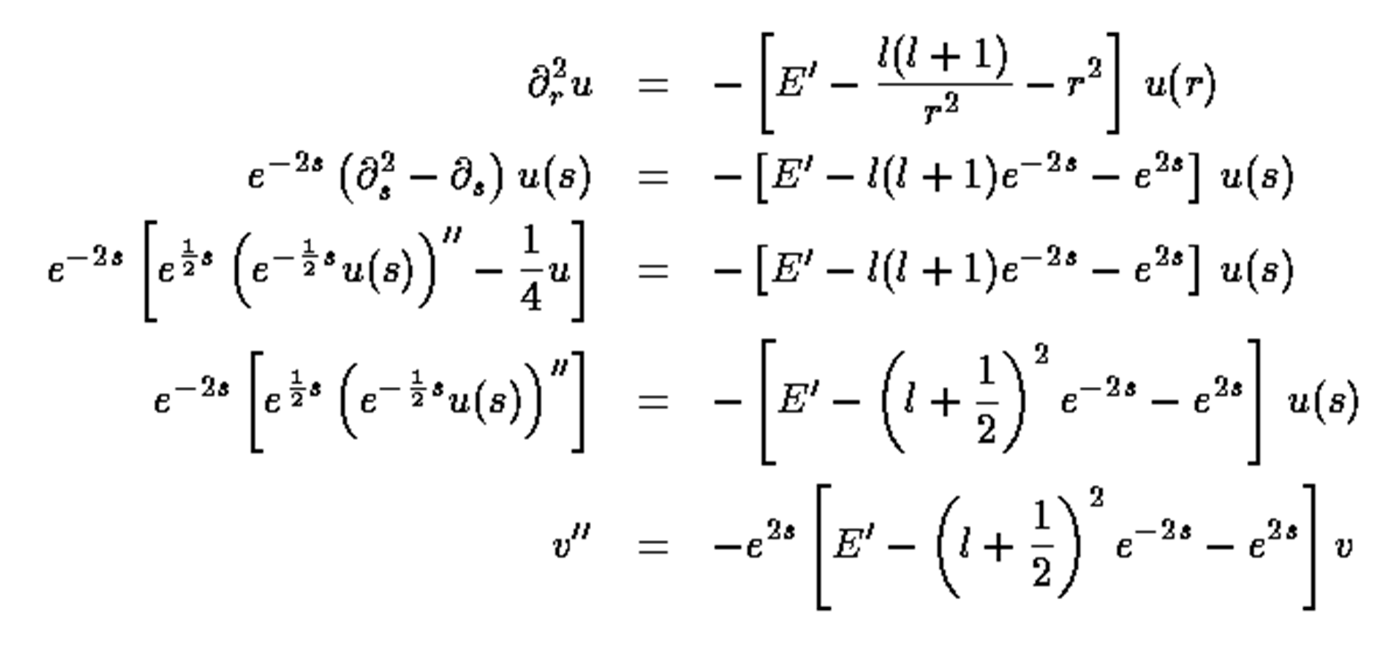
Mathematics
In 1996, a computer program written by researchers at Argonne National Laboratory proved a mathematical conjecture unsolved for decades
NY Times story: “[The proof] would have been called creative if a human had thought of it”
Mathematical software:

Slide 37
Logistics, scheduling, planning
During the
1991 Gulf War, US AI logistics planning
forces
and
deployed an
scheduling program that involved up to
50,000 vehicles, cargo, and people
NASA’s Remote Agent software operated the Deep Space 1 spacecraft during two experiments in May 1999
In 2004, NASA introduced the MAPGEN system to plan the daily operations for the Mars Exploration Rovers

Slide 38
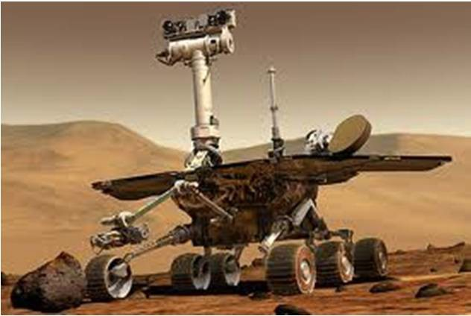
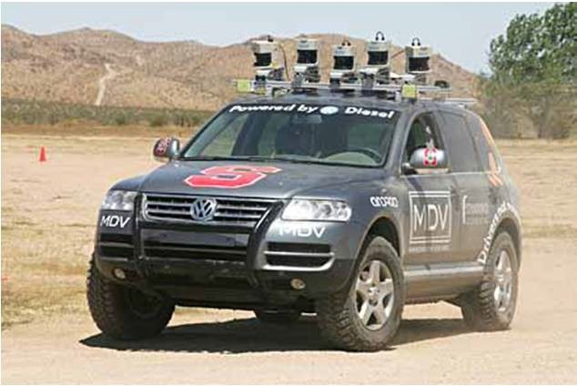

Robotics
Mars rovers
Autonomous vehicles
DARPA Grand Challenge
Self-driving cars
Autonomous helicopters
Robot soccer
RoboCup
Personal robotics
Humanoid robots
Robotic pets
Personal assistants?

Slide 39

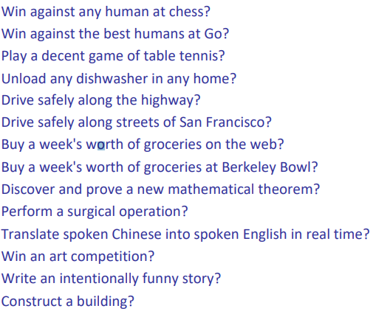
What AI systems can/can’t do yet?

Slide 40
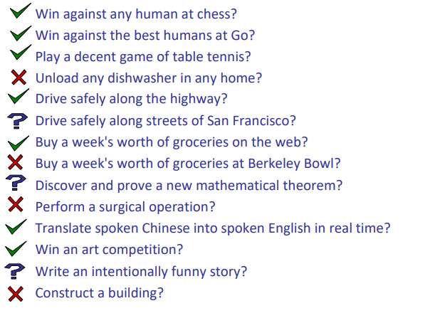
What AI systems can/can’t do yet?

Slide 41
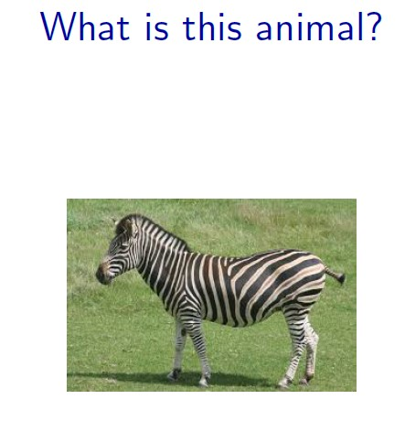

Slide 42

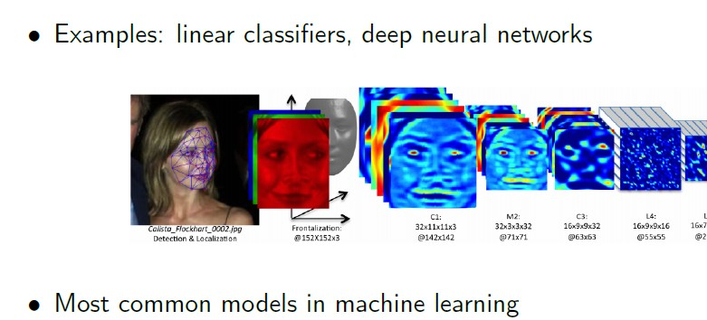

Slide 43
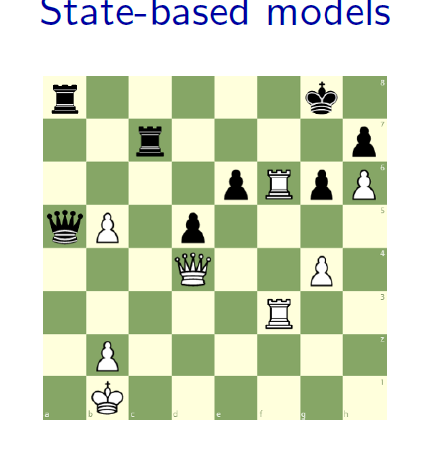

Slide 44
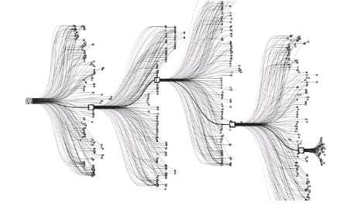
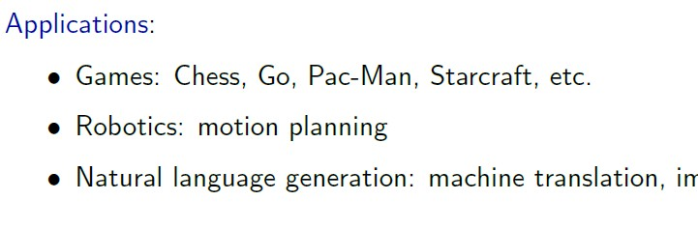

Slide 45
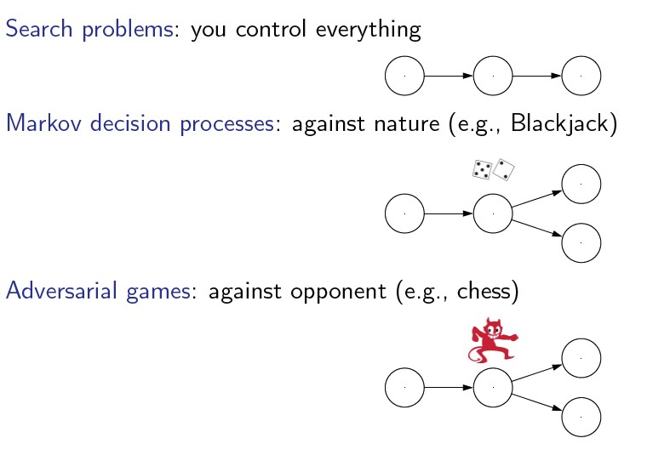
decision-making in situations where outcomes are partly random and partly under the control of a decision-maker

Slide 46
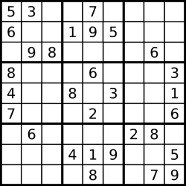
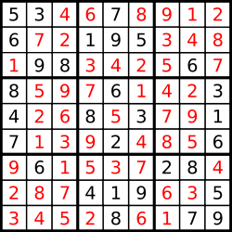
Sudoku
Goal: put digits in blank squares so each row, column, and 3x3 sub-block has digits 1–9
Key: order of filling squares doesn’t matter in the evaluation criteria!
State based Possible ??

Slide 47
Variable-based models
In state-based models, solutions are procedural: they specify step by step instructions on how to go from A to B.
In some applications, the order in which things are done isn’t important.
For example, in Sodoku, where the goal is to put digits in the blank squares to satisfy uniqueness constraints, all that matters is the final configuration of numbers; you can fill them in in any order.
This flexibility allows us to devise more efficient algorithms.

Slide 48
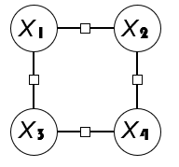
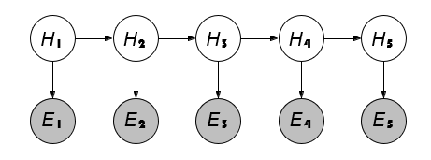
Constraint satisfaction problems are variable-based models where we only have hard constraints. For example, in scheduling, one person can’t be in two places at once.
Imagine scheduling 3 friends with different dietary restrictions for dinner: a vegan, a vegetarian, and someone with a shellfish allergy. Each restaurant caters to specific diets, so you need to find a restaurant that satisfies everyone's constraints for a happy dinner!
Bayesian networks are variable-based models where variables are random variables which are dependent on each other. For example, the true location of an airplane H_{t} and its radar reading E_{t} are related, as are the location H_{t} and the location at the last time step H_{t−1}. The exact dependency structure is given by the graph and it formally defines a joint probability distribution over all of the variables.

Slide 49
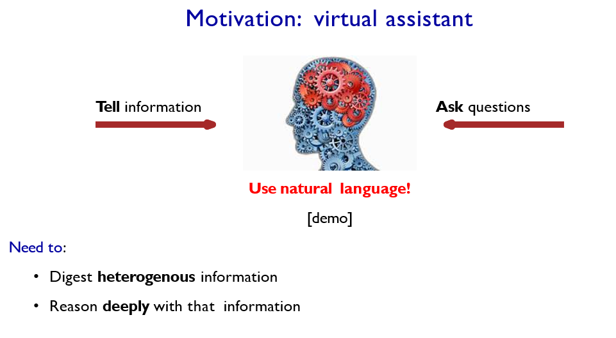

Slide 50
Logic
Natural Language Understanding: A virtual assistant must be able to understand and respond to human language, which requires logical reasoning to interpret the meaning and context of the user's input.
Information Processing: To be effective, a virtual assistant must be able to digest and process information from various sources. Logic provides a framework for organizing and analyzing this information.
Deep Reasoning: Virtual assistants should be able to reason deeply about the information they process, drawing conclusions and making informed decisions. Logic for sound arguments and decision-making.

Slide 51
Course plan
Search problems
Constraint satisfaction problems
Markov decision processes
Markov networks
Adversarial games
Bayesian networks
Reflex
States
Variables
Logic
”Low-level intelligence”
”High-level intelligence”
Machine learning

Slide 52
The End
46

